Slide 1

Computational Structures in Data Science
Lecture #2: Programming Structures: Loops and Functions
UC Berkeley EECS Adj. Ass. Prof. Dr. Gerald Friedland
January 27, 2020
https://cs88.org

Slide 2
Administrivia
If you are waitlisted: Please wait.
If you are concurrent enrollment: Please wait.
iClickers: Start next week.

Slide 3
Solutions for the Wandering Mind
A binary digit (bit) is a symbol from {0,1}.
How many strings can you represent with N bits?
Solution: 2^{N}
With 0 symbols: 2⁰=1, this is ‘’
With 1 symbol : 2¹=2, this is ‘0’, ‘1’
With 2 symbols: 2²=4, this is ‘00’, ‘01’, ‘10’, ‘11’
With 3 symbols: 2³=8, this is ‘000’, ‘001’, ‘010’, ‘011’, ‘100’, ‘101’, ‘110’, ‘111’
Could you build a program that compresses all strings of N bits to strings of M bits (with M<N) such that you can go back to all original strings of length N? How or Why?
Solution: No.
N bits represent 2^{N} strings. Assume M=N-1. M bits now represent 2^{N-1} strings. It is impossible to build a mapping from 2^{N-1} strings back to 2^{N} strings (pigeon hole principle). Example M=1, N=2: ‘00’->’0’, ‘11’->’1’ what do we do with ’01’ and ‘10’?
More on this: https://www.youtube.com/watch?v=yZ--bbmIp_o&t=0s&index=5&list=PL17CtGMLr0Xz3vNK31TG7mJIzmF78vsFO
UCB CS88 Sp19 L2

Slide 4

Computational Concepts Today
Fundamentals: Algorithm, Code, Data, Information
Conditional Statement
Functions
Iteration
02/04/19

Slide 5

Algorithm
An algorithm (pronounced AL-go-rith-um) is a procedure or formula to solve a problem.
An algorithm is a sequence of instructions to change the state of a system. For example: A computer’s memory, your brain (math), or the ingredients to prepare food (cooking recipe). Think Data 8: Change or retrieve the content of a table.
02/04/19

Slide 6
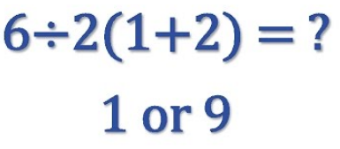
Algorithm: Properties
An algorithm is a description that can be expressed within a finite amount of space and time.
Executing the algorithm may take infinite space and/or time, e.g. ``calculate all prime numbers”.
In CS and math, we prefer to use well-defined formal languages for defining an algorithm.
02/04/19

Slide 7
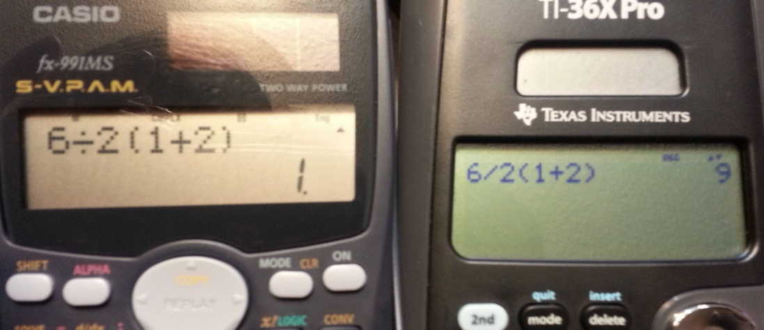
Algorithm: Well-definition
02/04/19

Slide 8
Algorithms early in life (1st grade)
1
Carry (MSD)
7
operands
8
operator
+
5
Least significant digit of result
02/04/19

Slide 9
Algorithms early in life (in binary)
1
1
0
0
Carry (MSD)
1
1
1
0
14
operands
1
1
0
0
+
12
operator
+
1
1
0
1
0
26
LSB result
02/04/19

Slide 10
More Terminology (intuitive)
Code
A sequence of symbols used for communication between systems (brains, computers, brain-to-computer)
Data
Observations
Information
Reduction of uncertainty in a model (measured in bits)
02/04/19

Slide 11
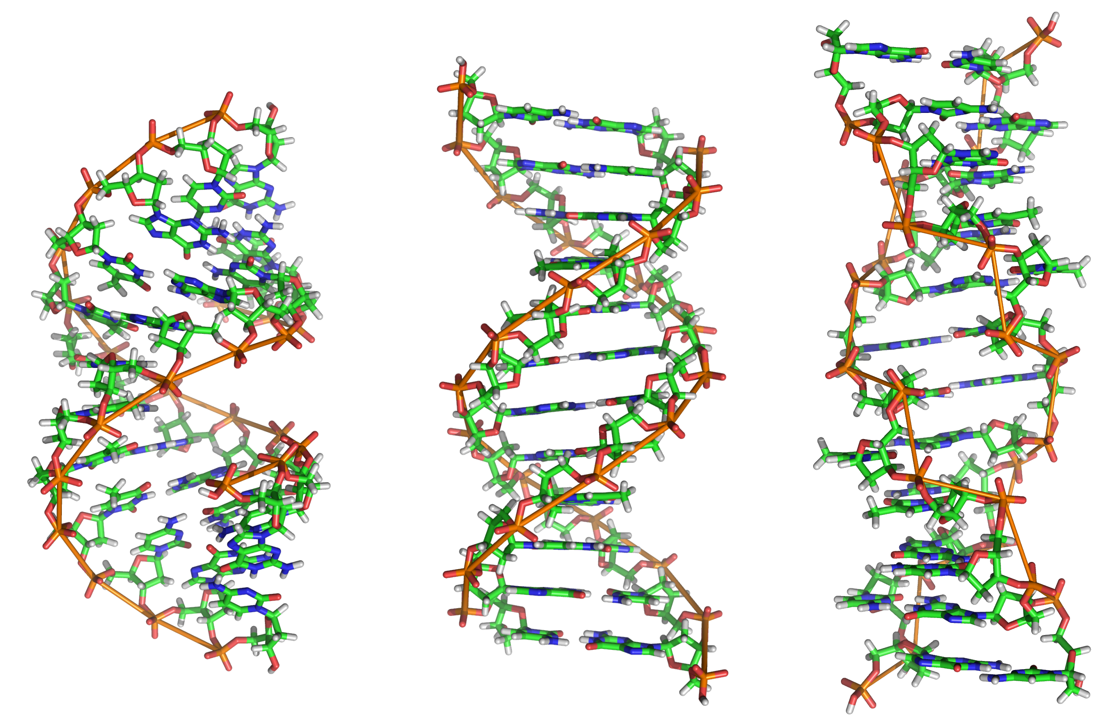
Data or Code?
02/04/19

Slide 12
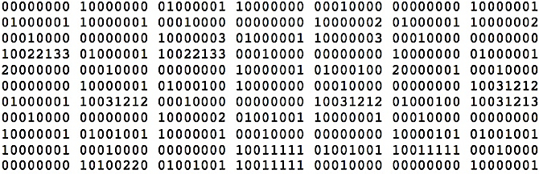
Data or Code?
02/04/19

Slide 13
Data or Code?
Here is some information!
Integer
Instruction
String
02/04/19

Slide 14
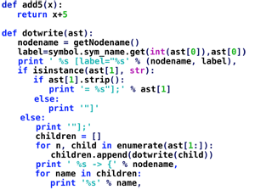
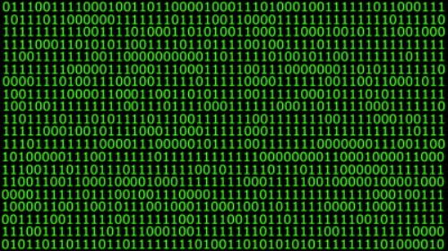
Data or Code? Abstraction!
Human-readable code (programming language)
Machine-executable instructions (byte code)
Compiler or Interpreter
Here: Python
02/04/19

Slide 15
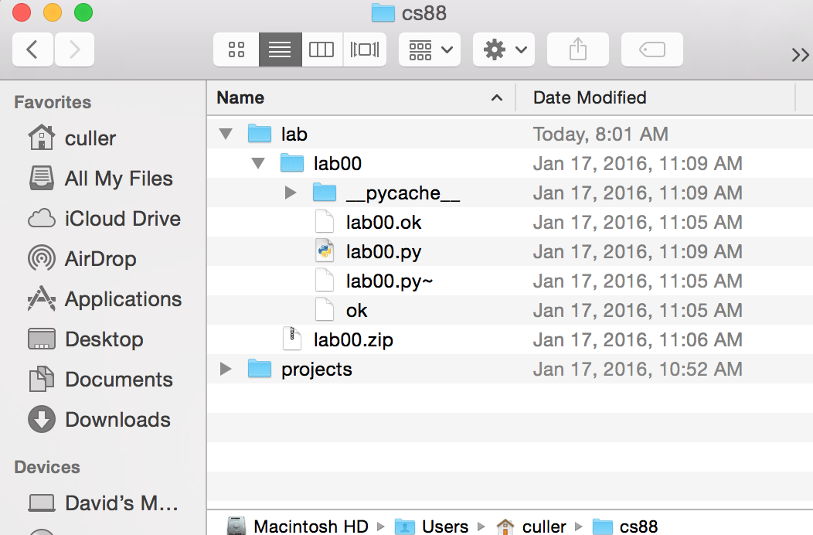
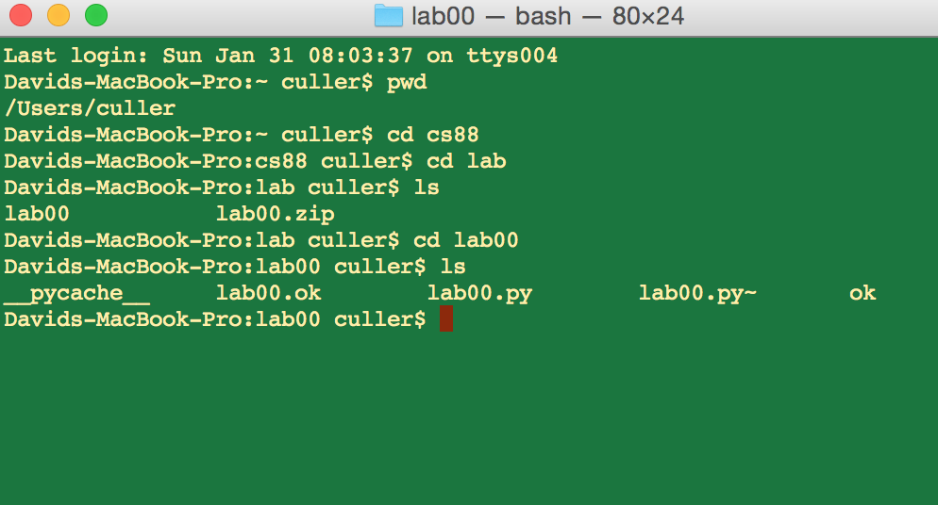
Code or GUI: More Abstraction!
Big Idea: Layers of Abstraction
The GUI look and feel is built out of files, directories, system code, etc.
02/04/19

Slide 16
Let’s talk Python
Expression 3.1 * 2.6
Call expression max(0, x)
Variables
Assignment Statement x = <expression>
Define Function:
Control Statements: if … for … while … list comprehension
def <function name> (<argument list>) :
02/04/19
Notes:
z = 1,2
x,y = 3,4
a,b = z

Slide 17
Conditional statement
Do some statements, conditional on a predicate expression
Example:
if <predicate>:
<true statements>
else:
<false statements>
if (temperature>37.2):
print(“fever!”)
else:
print(“no fever”)
02/04/19

Slide 18
Defining Functions
def <function name> (<argument list>) :
expression
return
Abstracts an expression or set of statements to apply to lots of instances of the problem
A function should do one thing well
02/04/19

Slide 19
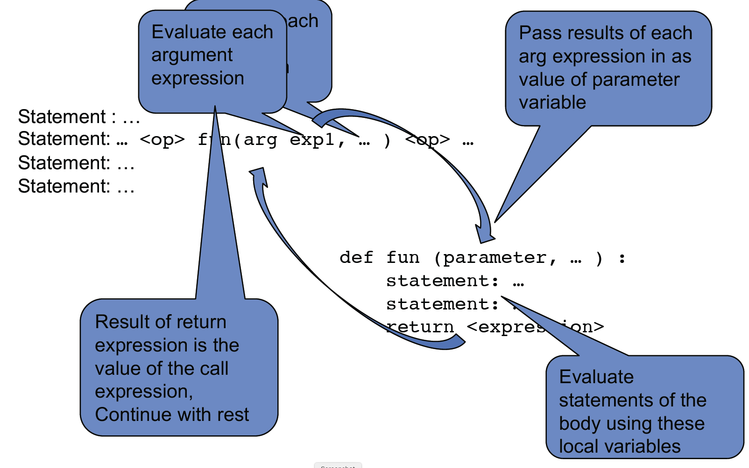
Functions: Calling and Returning Results
02/04/19

Slide 20
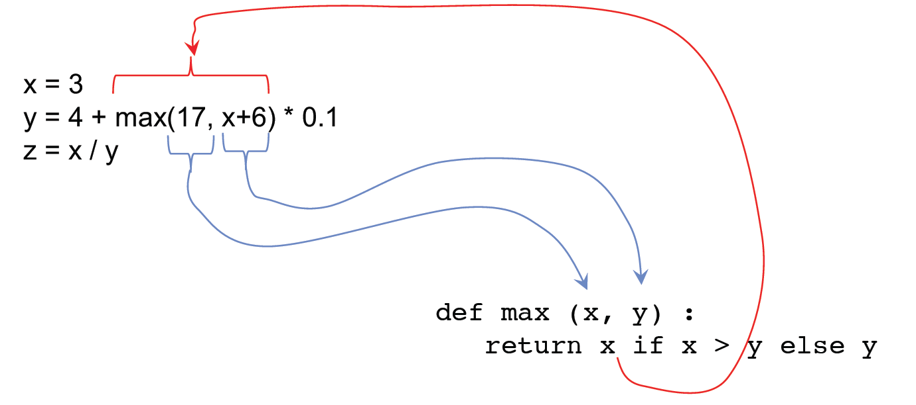
Functions: Example
02/04/19

Slide 21
How to write a good Function
Give a descriptive name
Function names should be lowercase. If necessary, separate words by underscores to improve readability. Names are extremely suggestive!
Chose meaningful parameter names
Again, names are extremely suggestive.
Write the docstring to explain what it does
What does the function return? What are corner cases for parameters?
Write doctest to show what it should do
Before you write the implementation.
Python Style Guide: https://www.python.org/dev/peps/pep-0008/
02/04/19

Slide 22
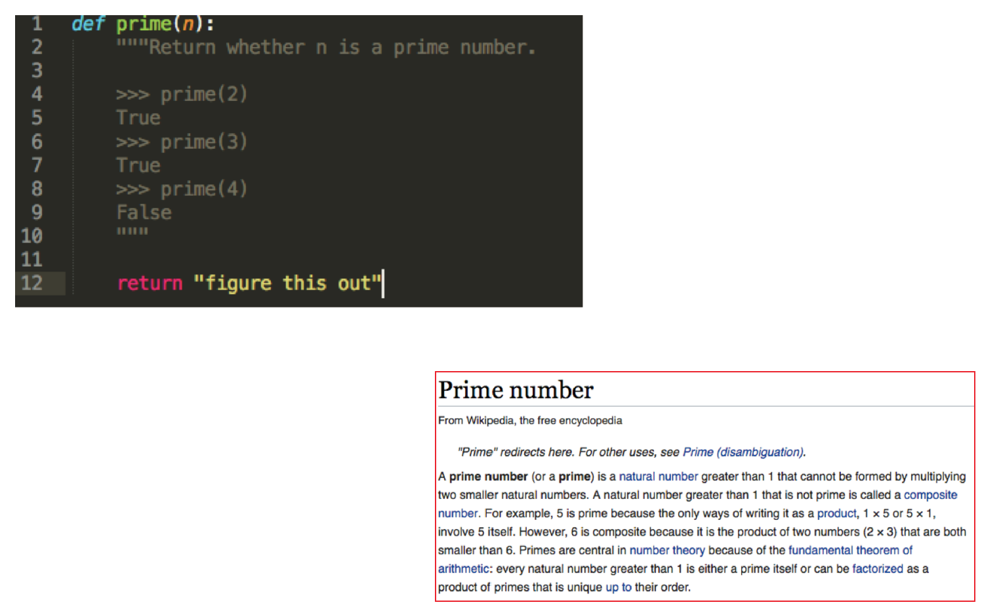
Example: Prime Numbers
Why do we have prime numbers?
https://www.youtube.com/watch?v=e4kevnq2vPI&t=72s&index=6&list=PL17CtGMLr0Xz3vNK31TG7mJIzmF78vsFO
02/04/19

Slide 23
for statement – iteration control
Repeat a block of statements for a structured sequence of variable bindings
<initialization statements>
for <variables> in <sequence expression>:
<body statements>
<rest of the program>
def cum_OR(lst):
"""Return cumulative OR of entries in lst.
>>> cum_OR([True, False])
True
>>> cum_OR([False, False])
False
"""
co = False
for item in lst:
co = co or item
return co
02/04/19

Slide 24
while statement – iteration control
Repeat a block of statements until a predicate expression is satisfied
<initialization statements>
while <predicate expression>:
<body statements>
<rest of the program>
def first_primes(k):
""" Return the first k primes.
"""
primes = []
num = 2
while len(primes) < k :
if prime(num):
primes = primes + [num]
num = num + 1
return primes
02/04/19

Slide 25
Data-driven iteration
describe an expression to perform on each item in a sequence
let the data dictate the control
[ <expr with loop var> for <loop var> in <sequence expr > ]
def dividers(n):
"""Return list of whether numbers greater than 1 that divide n.
>>> dividers(6)
[True, True]
>>> dividers(9)
[False, True, False]
"""
return [divides(n,i) for i in range(2,(n//2)+1) ]
02/04/19

Slide 26
Thoughts for the Wandering Mind
Could we build a complete computer that has no instructions, only data?
02/04/19
Notes:
Single Instruction Computer: See Patterson & Hennesey

